Slide 1
Essential Question:
What caused an Industrial Revolution in England in the 1800s?
Warm Up Question:

Slide 2
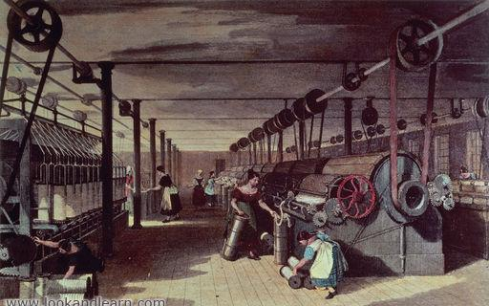
In the mid-1700s, an Industrial Revolution began in England that transformed the way work was done
Rather than making goods by hand, new machines mass-produced products which lowered costs, increased profits, & changed the way people lived
By 1900, industrialization spread through Europe & to the United States transforming the West into the dominant region of the world
What caused the Industrial Revolution & why did it begin in England?

Slide 3
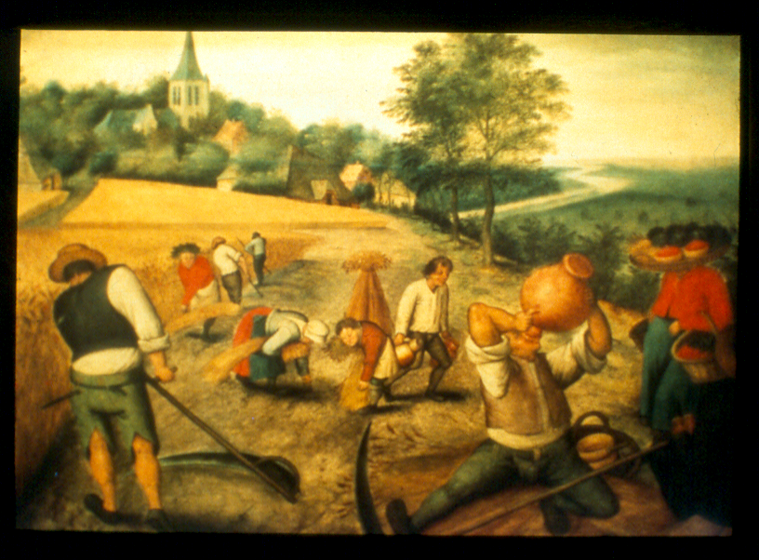
What was life like before the Industrial Revolution?

Slide 4
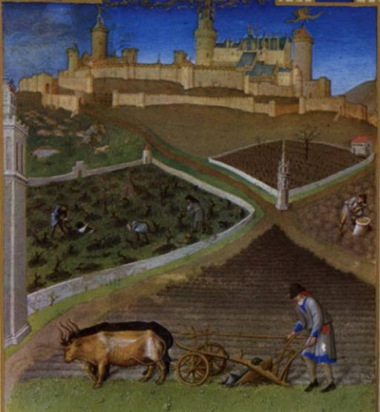
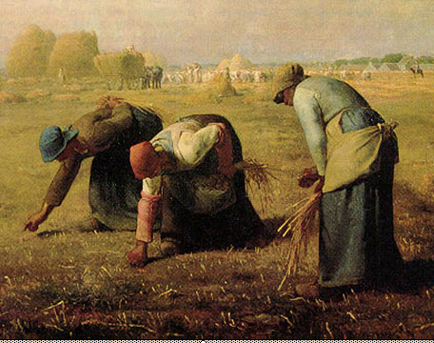
Before the Industrial Revolution, most Europeans worked & lived on small farming villages using inefficient methods of farming
Farmers relied on the medieval & inefficient three-field system
Few farmers experimented with new farm techniques
As a result, the food that was produced kept the population of Europe from growing rapidly

Slide 5
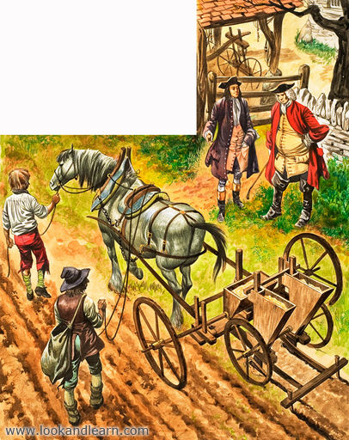
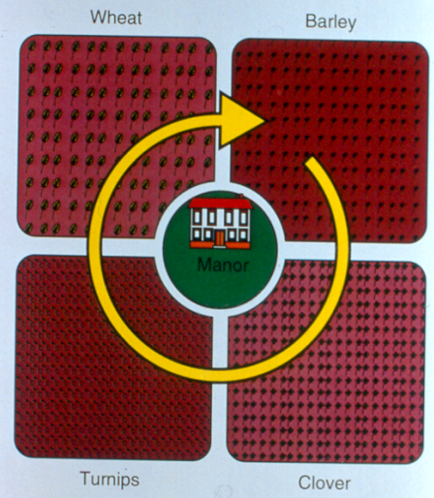
In the mid-1700s new farm techniques led to an Agricultural Revolution in Europe
Fences were used to protect large farms (called the enclosure movement)
Scientific farming methods like crop rotation maximized farmland & increased production
New crops like corn & potatoes were introduced
New tools like the iron plow & seed drill made farming more efficient

Slide 6
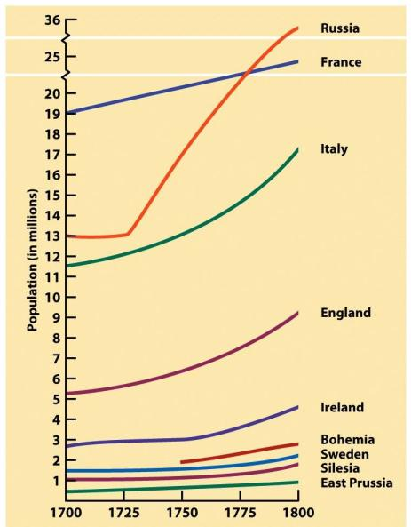
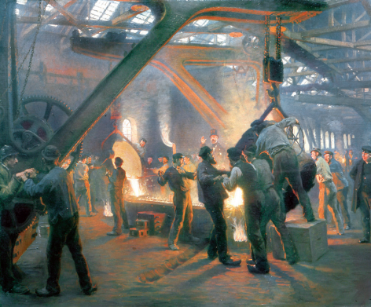
As a result of this agricultural revolution, more food was made & Europe’s population increased…
…This large population of workers who would soon find work in industrial factories

Slide 7
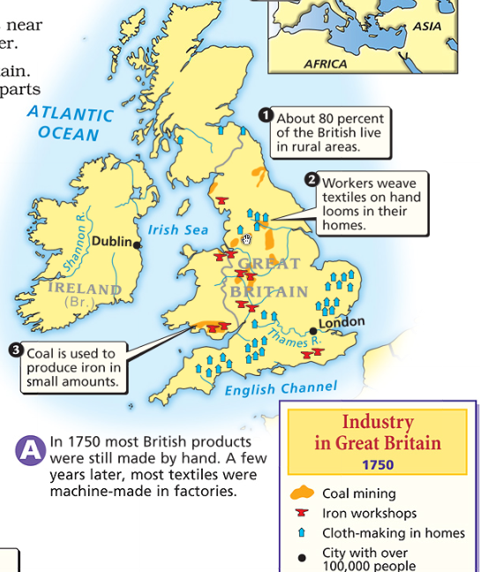
The Industrial Revolution began in England for a variety of reasons
England had large deposits of natural resources, especially iron & coal
England had banks, a gov’t that encouraged trade & invention, & money to invest in industry
England’s colonies provided cheap raw materials & markets to sell industrial goods

Slide 8
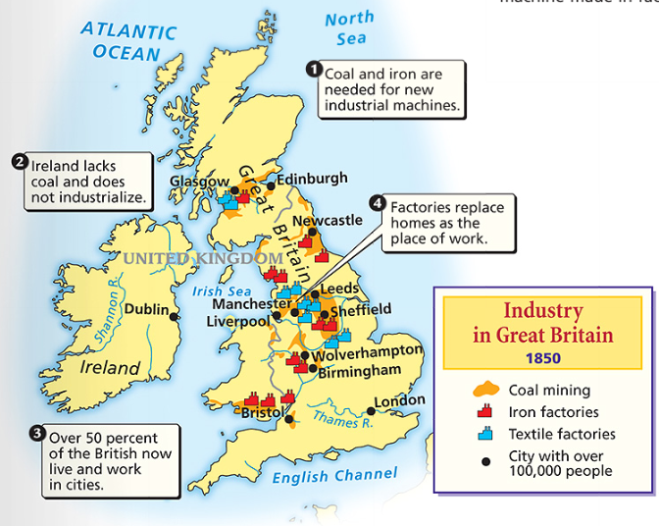
From 1750 to 1850, England was the most industrialized nation in the world
Notes:
Factors of Production required to industrialize – Land (natural resources), Labor (human input in process), and Capital (any final product used in the production of other goods – example: machinery, cotton gin, etc)

Slide 9
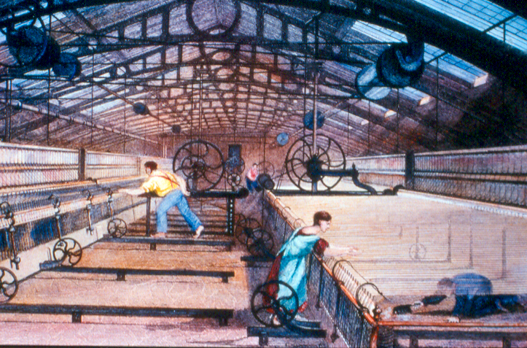
What was the first industry to industrialize?

Slide 10
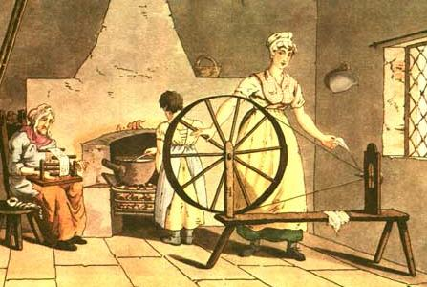
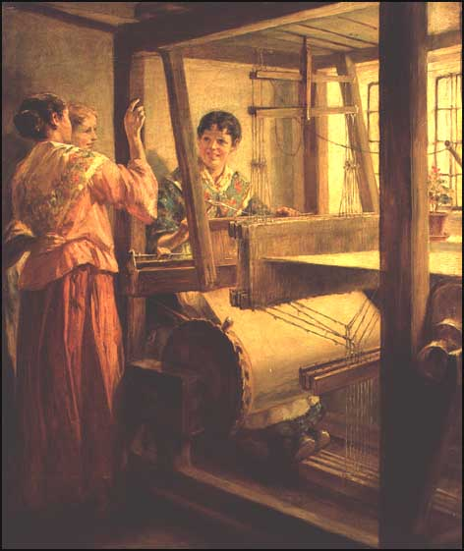
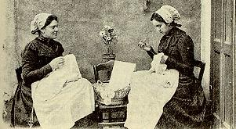
The population boom created a demand for clothing but traditional methods of textile making were slow
As a result, the textile industry became the first to become industrialized

Slide 11
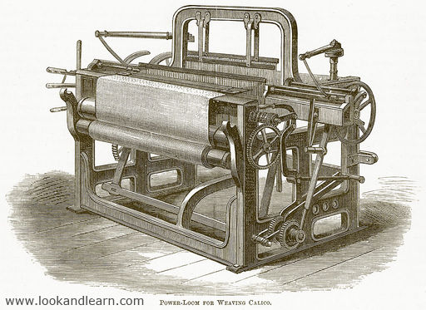
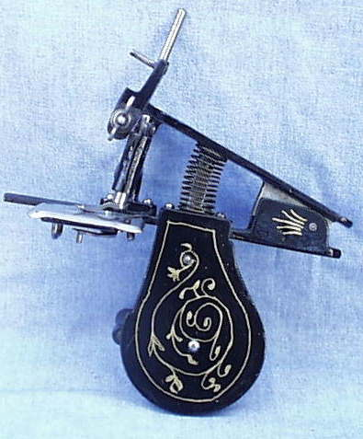
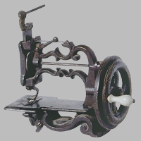
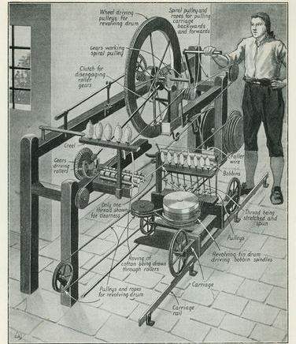
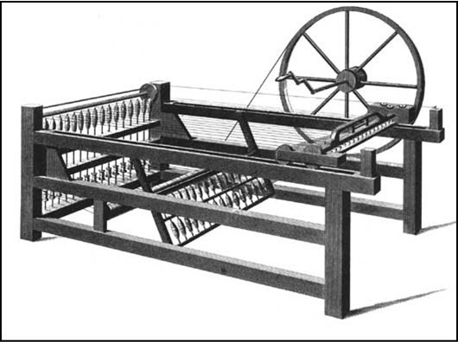
What do these inventions do?
Spin yarn
Sewing machine
Weave yarn into cloth
New inventions sped up spinning, weaving, sewing

Slide 12
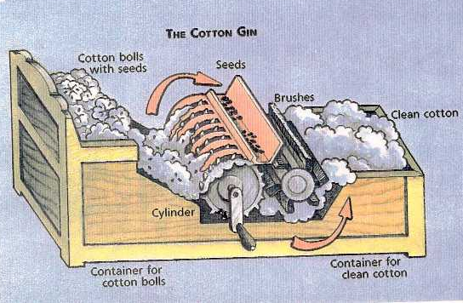
What do these inventions do?
European demand for cotton led to a boom in cotton production and slavery in the southern United States
Cotton gin
Eli Whitney’s invention of the cotton gin stimulated a demand for cotton textiles

Slide 13
New textile machinery led to the factory system
Power-driven machines were able to mass-produce goods very fast & cheap
Factory owners made huge profits selling mass-produced clothes
Notes:
Mechanization: process of changing from working largely or exclusively by hand or with animals to doing that work with machinery. Increased productivity for the manufacturer & lowered prices for the consumer.

Slide 14
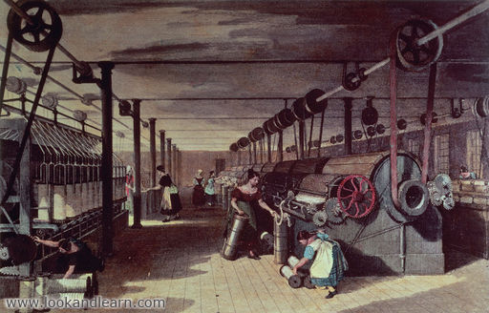
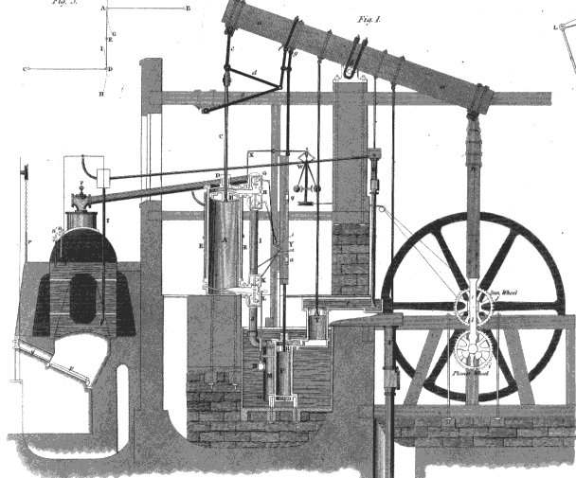
The textile industry & the rise of the factory system led to the growth of other industries
Factories needed power & were usually located near rivers
In 1765, James Watt invented the first steam engine
Steam engines produced more power & allowed factories to be built in cities near workers

Slide 15
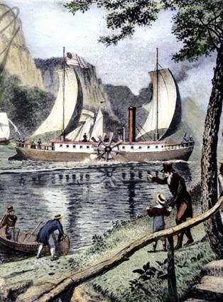
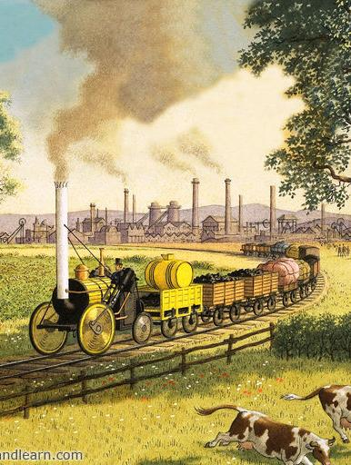
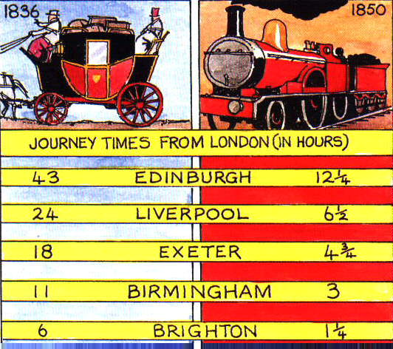
The textile industry & the rise of the factory system led to the growth of other industries
Factories led to a demand for faster transpiration
Roads & canals were built in England; Robert Fulton’s steamboat increased the speed of water travel
The greatest improvement to transportation was the steam-powered railroad
RRs were fast, increased profits, & stimulated the iron & coal industries
Notes:
Railroads Revolutionize Life in Britain
The invention and perfection of the locomotive had at least four major effects. First, railroads spurred industrial growth by giving manufacturers a cheap way to transport materials and finished products. Second, the railroad boom created hundreds of thousands of new jobs for both railroad workers and miners. These miners provided iron for the tracks and coal for the steam engines. Third, the railroads boosted England’s agricultural and fishing industries, which could transport their products to distant cities. Finally, by making travel easier, railroads encouraged country people to take distant city jobs. Also, railroads lured city dwellers to resorts in the countryside. Like a locomotive racing across the country, the Industrial Revolution brought rapid and unsettling changes to people’s lives.

Slide 16
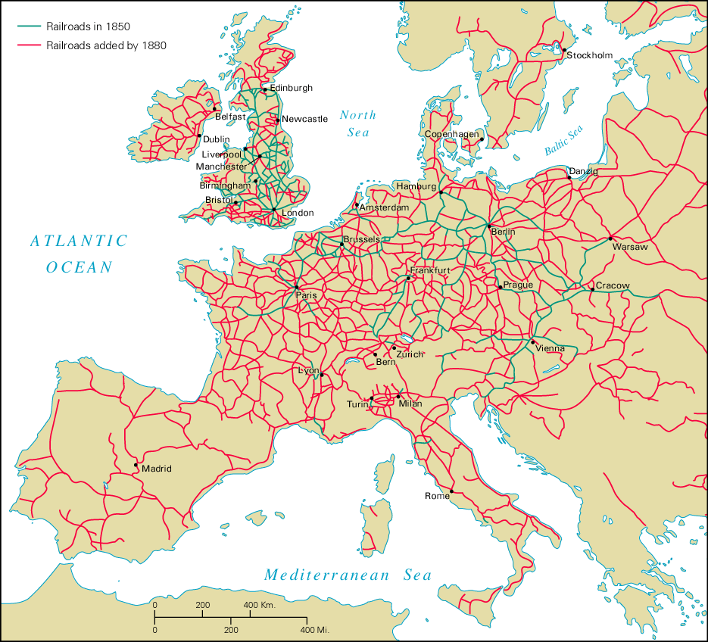
Growth of Railroads, 1850-1880

Slide 17
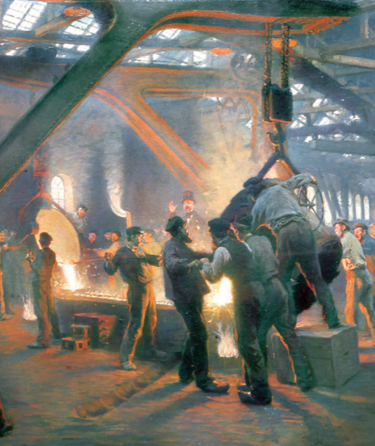
The textile industry & the rise of the factory system led to the growth of other industries
The Industrial Revolution led to an increase in coal to power factories & RRs
Iron was needed to produce new machines, engines, & railroad track
By 1800, England made more iron than all other nations in the world combined

Slide 18
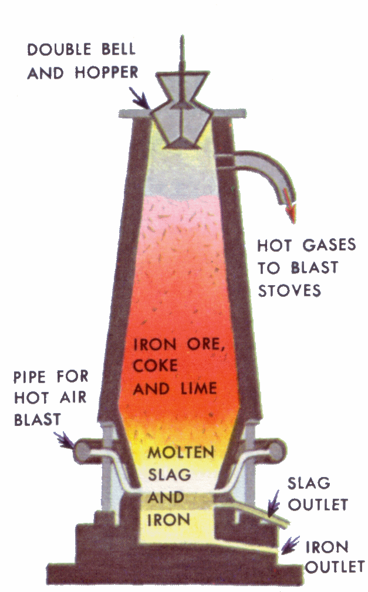
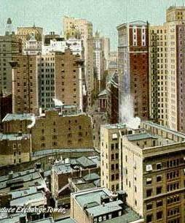
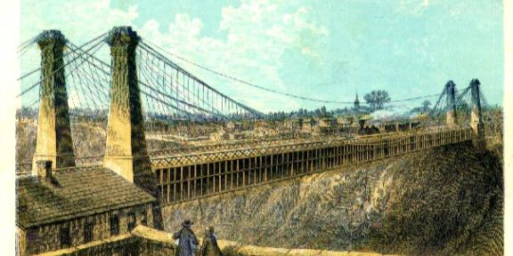
The textile industry & the rise of the factory system led to the growth of other industries
Henry Bessemer invented a cheap process for making steel which is stronger than iron
Steel allowed engineers to design more powerful machines, taller buildings, & longer bridges

Slide 19
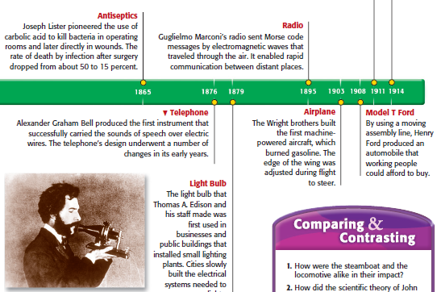
Other inventions of the Industrial Revolution include electricity, new forms of communication such as the telegraph & telephone, business machines like typewriters & cash registers, and medical improvements like vaccines

Slide 20
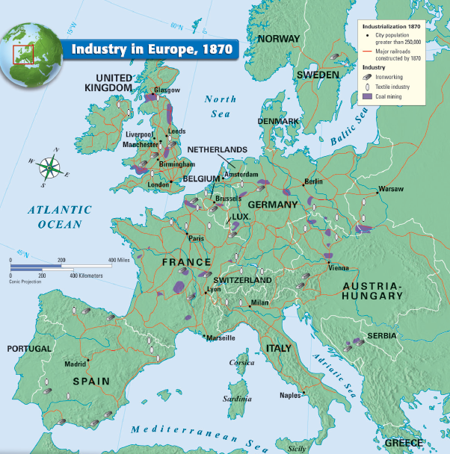
The Industrial Revolution soon spread throughout Europe & America
Germany was quick to embrace new industrial technologies
Germany had large supplies of coal & iron ore
Germans built a large network of railroads, iron & textile factories
By the mid 1800s, Germany was one of the world’s industrial leaders & built a powerful modern militaries
Notes:
Germany was politically divided in the early 1800s. Economic isolation and scattered resources hampered countrywide industrialization. Instead, pockets of industrialization appeared, as in the coal-rich Ruhr Valley of west central Germany. Beginning around 1835, Germany began to copy the British model. Germany imported British equipment and engineers. German manufacturers also sent their children to England to learn industrial management. Most important, Germany built railroads that linked its growing manufacturing cities, such as Frankfurt, with the Ruhr Valley’s coal and iron ore deposits. In 1858, a German economist wrote, “Railroads and machine shops, coal mines and iron foundries, spinneries and rolling mills seem to spring up out of the ground, and smokestacks sprout from the earth like mushrooms.” Germany’s economic strength spurred its ability to develop as a military power. By the late 1800s, a unified, imperial Germany had become both an industrial and a military giant.

Slide 21
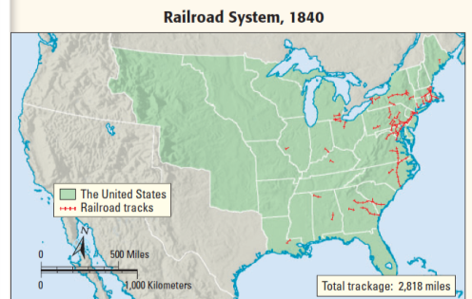
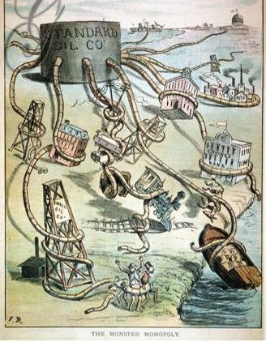
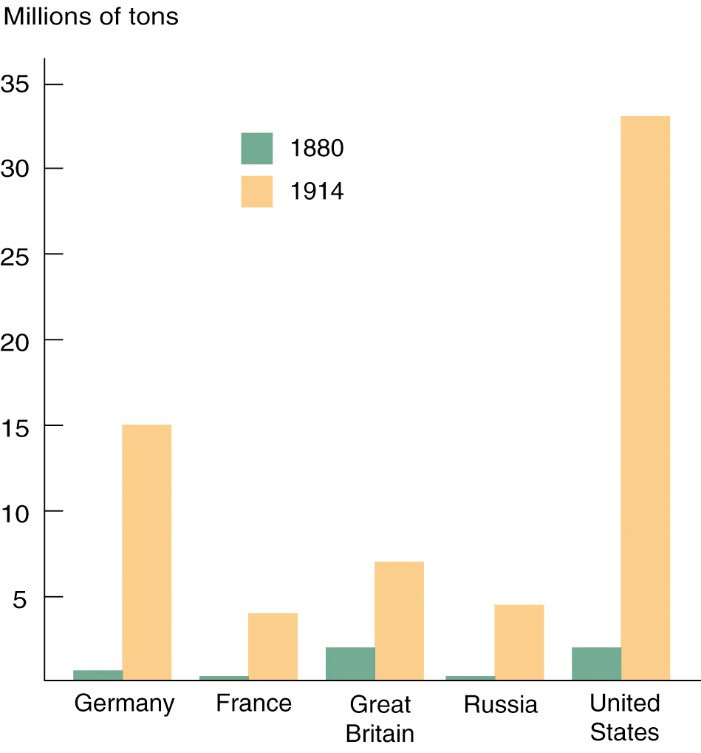
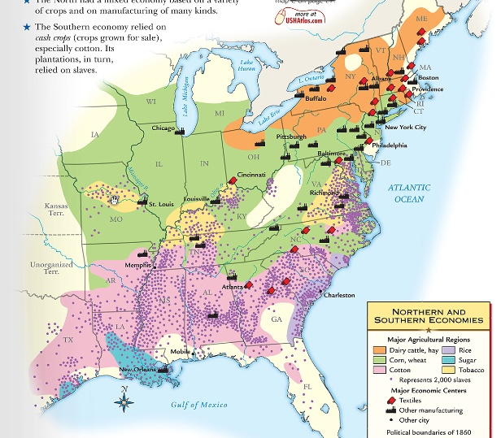
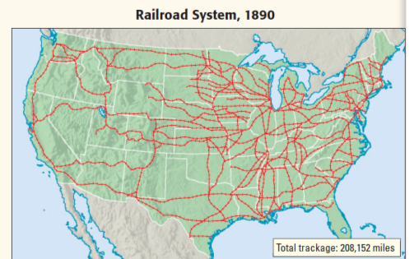
The Industrial Revolution soon spread throughout Europe & America
Industrial ideas turned the United States into an important world power
Southern cotton led to textile mills in the North
After the Civil War in 1865, American industry boomed & the United States became a world leader in railroads, oil, steel, electricity
Many U.S. companies merged to form large corporations & monopolies
Notes:
Germany was politically divided in the early 1800s. Economic isolation and scattered resources hampered countrywide industrialization. Instead, pockets of industrialization appeared, as in the coal-rich Ruhr Valley of west central Germany. Beginning around 1835, Germany began to copy the British model. Germany imported British equipment and engineers. German manufacturers also sent their children to England to learn industrial management. Most important, Germany built railroads that linked its growing manufacturing cities, such as Frankfurt, with the Ruhr Valley’s coal and iron ore deposits. In 1858, a German economist wrote, “Railroads and machine shops, coal mines and iron foundries, spinneries and rolling mills seem to spring up out of the ground, and smokestacks sprout from the earth like mushrooms.” Germany’s economic strength spurred its ability to develop as a military power. By the late 1800s, a unified, imperial Germany had become both an industrial and a military giant.

Slide 22
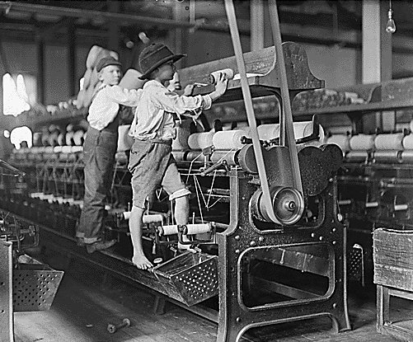
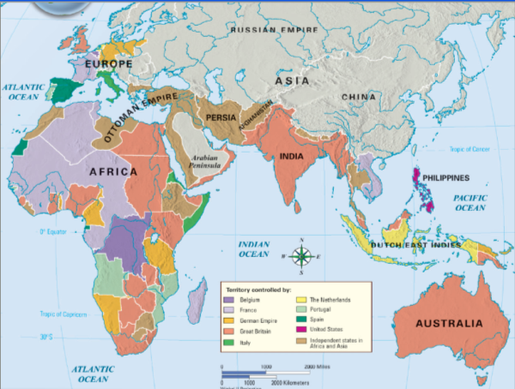
Conclusions: From 1700 to 1900, revolutions in agriculture, industry, transportation, & communication changed Western Europe and the United States
Industrialization gave Europe tremendous economic & military power
Industry also had numerous negative effects on working conditions & the standard of living for urban workers
Notes:
Between 1700 and 1900, revolutions in agriculture, production, transportation, and communication changed the lives of people in Western Europe and the United States. Industrialization gave Europe tremendous economic power. In contrast, the economies of Asia and Africa were still based on agriculture and small workshops. Industrialization revolutionized every aspect of society, from daily life to life expectancy. Despite the hardships early urban workers suffered, population, health, and wealth eventually rose dramatically in all industrialized countries. The development of a middle class created great opportunities for education and democratic participation. Greater democratic participation, in turn, fueled a powerful movement for social reform.

