Slide 1
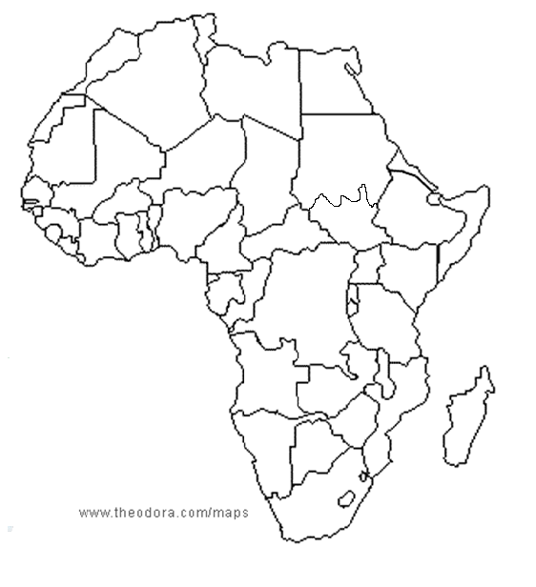

Slide 2
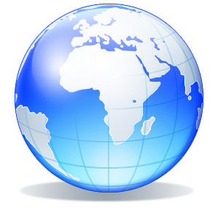
Physical Geography of Africa: The Plateau Continent
Africa is a continent of plateaus, basins, and rift valleys; Africa features dense rain forests, vast grasslands, and the world’s largest desert.

Slide 3
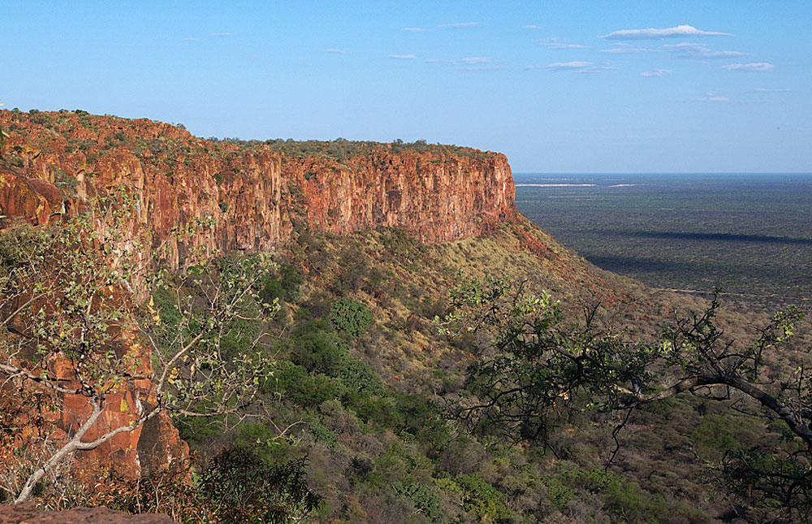
Section 1: Landforms and Resources
A large plateau covers most of Africa.
Africa’s natural resources made it appealing to European colonizers

Slide 4
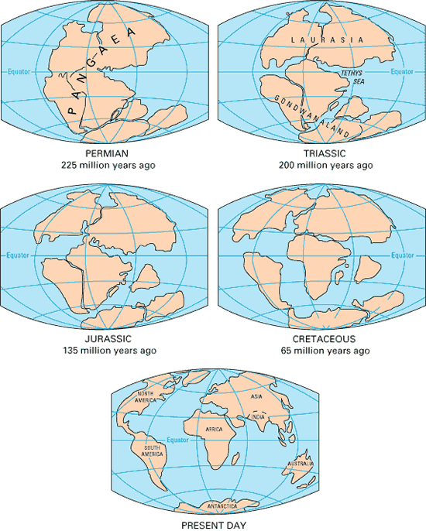
A Vast Plateau
After Pangaea
Pangaea supercontinent broke up 200 million years ago
Africa moved very little, unlike Americas, Antarctica, Australia, and India.
Africa is second largest continent.
http://geology.com/pangea.htm

Slide 5
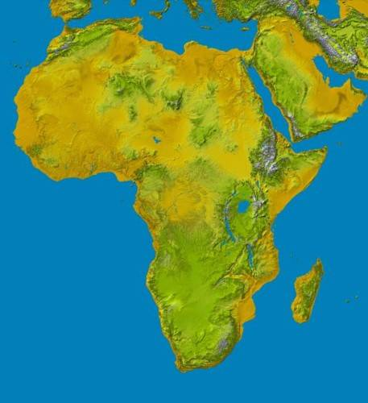
Africa’s Plateau
Huge plateau covers most of Africa, rising inland from coasts
Most of Africa is at least 1,000 feet above sea level
known as the “plateau continent”
http://goafrica.about.com/od/africatraveltips/ig/Maps-of-Africa/Topographical-Map-of-Africa.htm

Slide 6
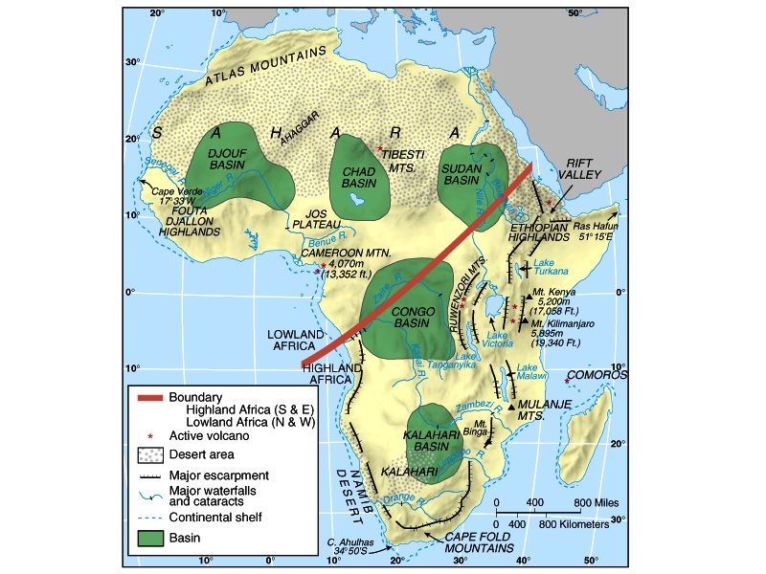
Basins and Rivers
Basins— a huge depression on a plateau
Each is more than 625 miles across, up to 5,000 feet deep.

Slide 7
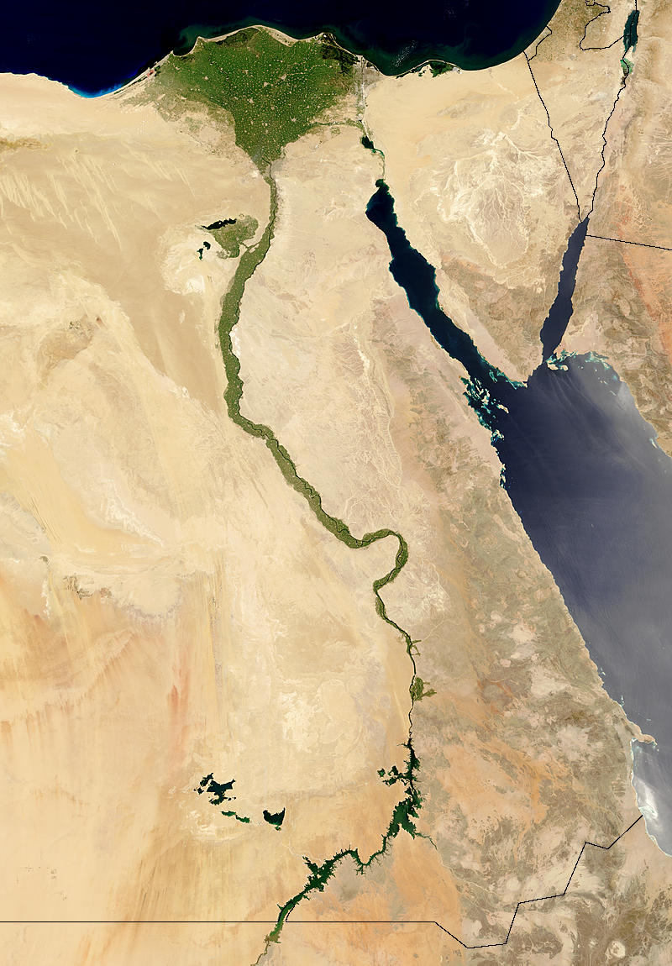
Nile River —world’s longest river: 4,000 miles through Uganda, Sudan, South Sudan, and Egypt.
Waters are used for irrigation; 95% of Egyptians get water from the Nile.
Egypt’s population density near the Nile is 3,320 people per square mile
Only 177 per square mile overall.

Slide 8
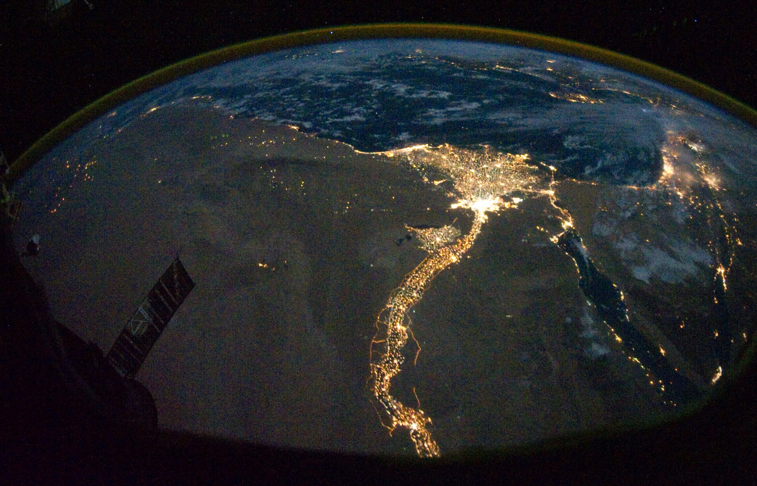
Nile River Valley

Slide 9
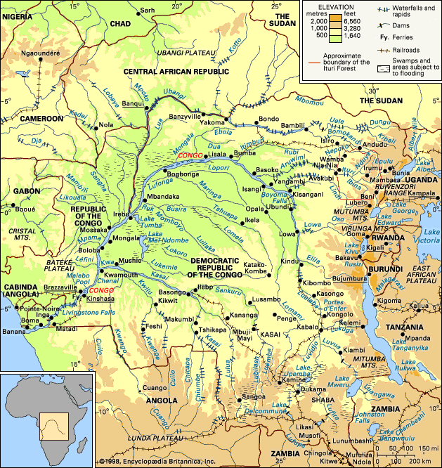
Distinctive African Landforms
Basins and Rivers
Waterfalls, rapids, and gorges make rivers less useful for transportation.
2,900-mile Congo is largest river network.
32 cataracts (waterfalls) make much of Congo impassable.
Rivers’ meandering courses also make them less useful
http://apsolutionsltd.co.uk/ka-congo-river-on-map/index.htm

Slide 10
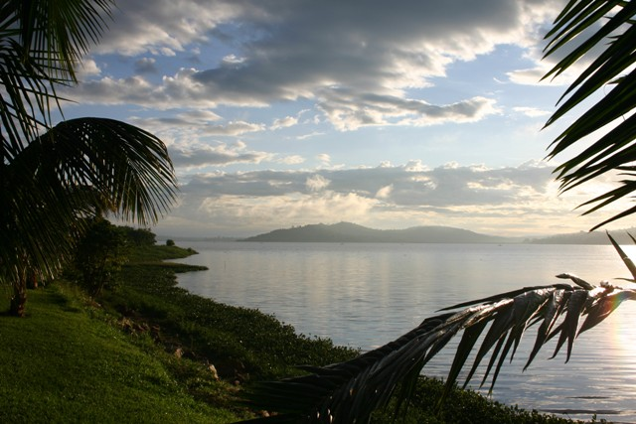
Rift Valleys and Lakes
East Africa: continental shift created huge cracks in East Africa.
Land sank, formed long, thin rift valleys.
stretch 4,000 miles from Jordan to Mozambique
Eastern part is still slowly pulling away from Africa.
Long, deep lakes form at bottoms of rift valleys
Lake Tanganyika is the longest freshwater lake in world.
Lake Victoria is Africa’s largest lake; it sits in a basin between rift valleys.
Lake Victoria
http://www.escapetoafrica.net/parks/Lake-Victoria.aspx

Slide 11
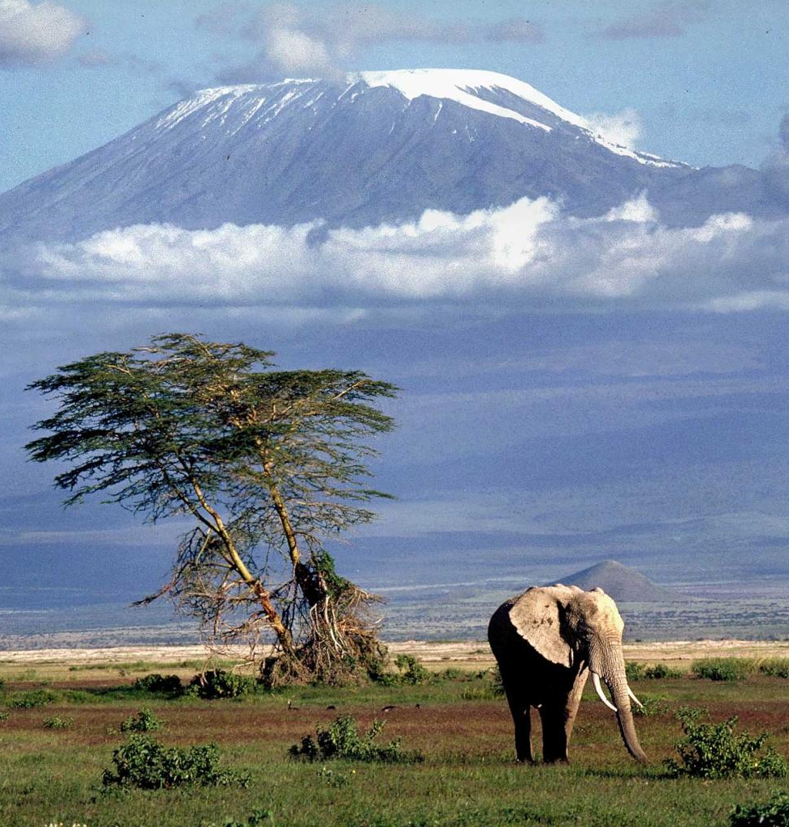
Mountains
Africa mainly has volcanic mountains: Mount Kenya, Mount Kilimanjaro.
Mount Kilimanjaro is Africa’s highest mountain
Volcanoes created Ethiopian Highlands
Also Tibesti Mountains (Sahara), Mount Cameroon (West Africa)
Volcanic rock covers Great Escarpment in Southern Africa
Escarpment—steep slope with flat plateau on top
http://inouganda.com/mt-kilimanjaro/

Slide 12
Africa’s Wealth of Resources
A Wealth of Minerals
Africa’s minerals make it one of world’s richest continents
Copper, phosphates, diamonds; 42% of world’s cobalt.
South Africa is largest producer of chromium, for stainless steel
produces 80% of world’s platinum, 30% of gold.
Mineral wealth has not created general African prosperity
Colonial rulers sent natural resources to Europe.
Nations are slow to develop infrastructure, industries.

Slide 13
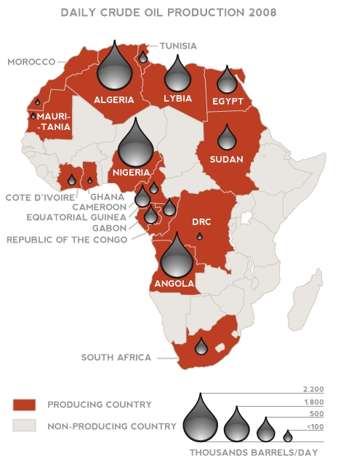
Oil Resources
Libya, Nigeria, Algeria among world’s leading petroleum producers
Angola, Gabon have untapped oil reserves
Angola is example of resources not benefiting Africans
Oil deposits will make it Africa’s most oil-rich country
American companies will pay Angola to drill oil
Money will be spent on ongoing ethnic civil war
Little will be invested in schools, hospitals, and other infrastructure
http://marketjigsawpuzzle.blogspot.com/2011/02/libya-corporate-threat-assessment.html

Slide 14
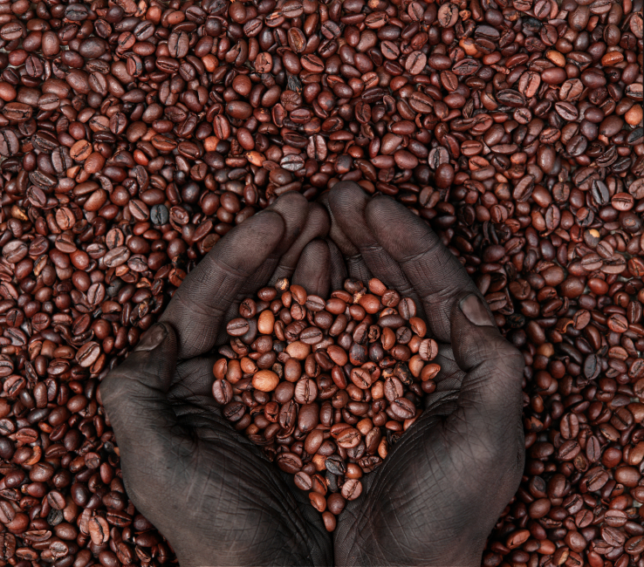
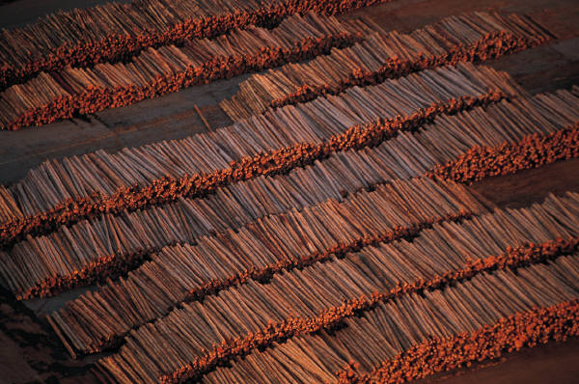
Diversity of Resources
Major Commodities
Coffee is Africa’s second most profitable commodity
Few Africans drink coffee, but 20% of world’s supply is grown there.
Nigeria leads in lumber exports, but logging is depleting forests.
Each year an area twice the size of New Jersey is cleared.
Other commodities include sugar, palm oil, and cocoa.
Agriculture is Africa’s single most important economic activity
66% of Africans earn a living farming; this accounts for 1/3 of their exports.

Slide 15
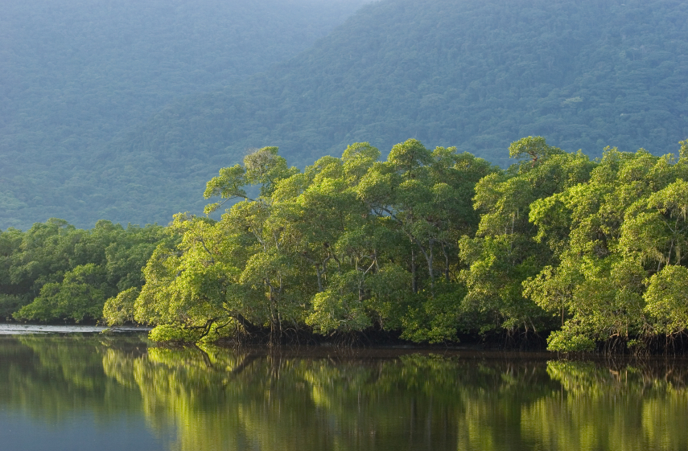
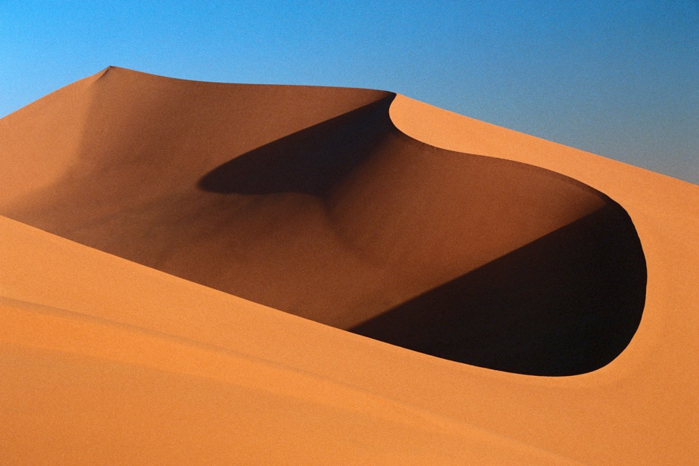
Section 2: Climate and Vegetation
Africa contains dry and hot deserts, warm tropics, and permanently snowcapped mountains.
Africa’s vegetation includes thick rain forests, tall grasslands, and desert areas.

Slide 16
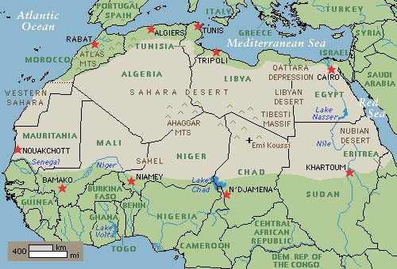
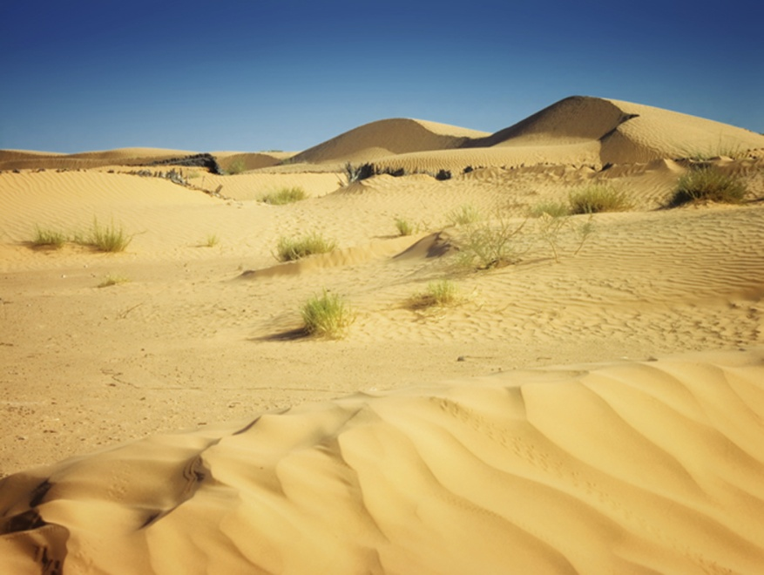
A Warm Continent
The Deserts
Sahara is largest desert in world; name means “desert” in Arabic.
3,000 miles from Atlantic to Red Sea; 1,200 miles north to south.
Temperatures as high as 136° in summer, and freezing at night.
Fewer than 2 million of Africa’s 800 million people live in the Sahara.
Only 20% is sand; rest is mountains, rocks, or gravelly plains.
Tibesti Mountains in northwestern Chad rise 11,000 feet
http://www.wonderfulinfo.com/winfo/naturalwonders/

Slide 17
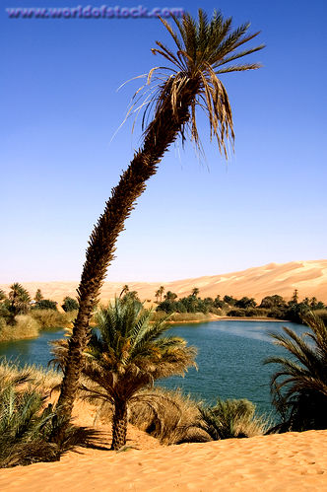
The Deserts
Saharan travelers rely on camels that can go 17 days without water.
6,000 feet under Sahara are aquifers—stores of underground water.
When this water comes to the surface it creates an oasis.
Other African deserts include Kalahari, and the Namib.
http://www.worldofstock.com/stock-photos/mandara-oasis-libya-north-africa/TAF2481

Slide 18
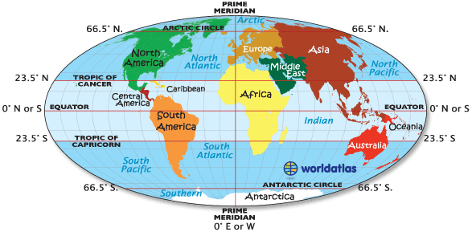
The Tropics
Africa has the largest tropical area of any continent.
90% of Africa lies between Tropics of Cancer and Tropic of Capricorn.
High temperatures year around; especially in Somalian Sahara.
Africans say nighttime is the “winter” of the tropics.
http://www.wildlifeden.com/projects/tropic-of-capricorn/

Slide 19
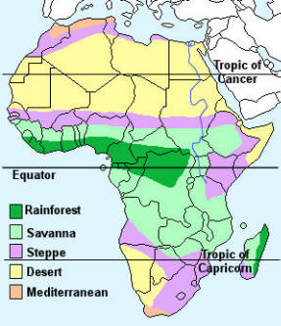
Africa’s Moderate Areas
Mediterranean climate on northern, southern tips of Africa
clear blue skies, moderate summers, rain in winter
http://www.naturalhistoryonthenet.com/Continents/africa.htm

Slide 20
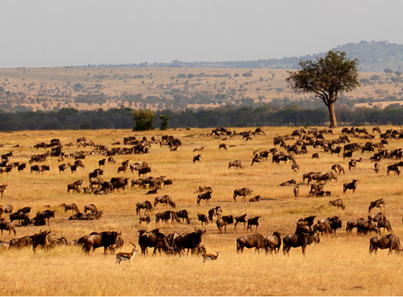
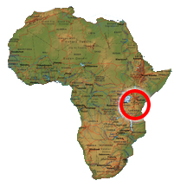
A Grassy Continent
Tropical Grassland
Tropical grassland covers most of Africa
Serengeti Plain —northern Tanzania grassland
dry climate, hard soil prevent growth of trees, crops
Serengeti National Park has best grasslands in the world
some grasses grow taller than a person
ideal for grazing animals like wildebeests, gazelles, zebras
site of largest numbers of migrating land mammals

Slide 21
Serengeti Migration

Slide 22
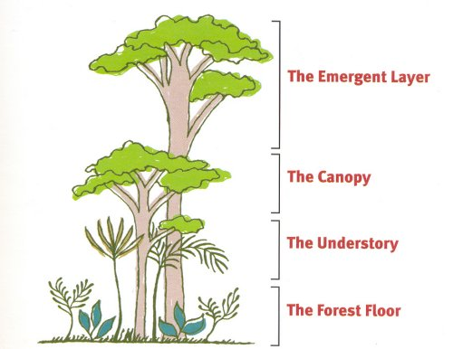
Africa’s Extremes
Rain Forest
Major tropical rain forests are on equator in the Congo Basin.
A square acre can have hundreds of different types of trees and birds.
Plants, trees, leaves block out most sunlight; air is hot, moist.
Plants, vegetation decay 8 times faster than in Europe
Most animals live in canopy—uppermost branches, 150 feet off ground.
Birds, monkeys, flying foxes, and snakes can live in the canopy.
http://mrsgebauer.com/rainforestweb/WebQuest.htm

Slide 23
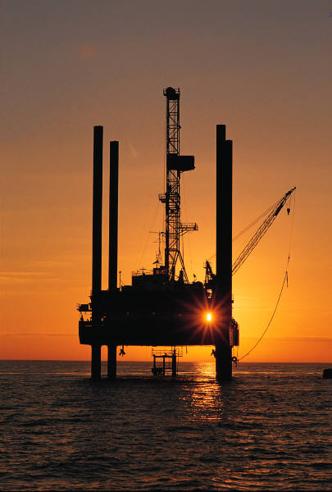
Section 3: Human-Environment Interaction
The Sahara’s expansion is causing problems for Africa’s farmers.
The Nigerian oil industry has caused serious environmental damage in the Niger delta.

Slide 24
Desertification of the Sahel
The Spreading Sahara
Sahel means “shore of the desert”
Narrow band of grassland runs east-west along southern Sahara edge
used for farming, and herding.
Since 1960s, desert has spread into the Sahel.
Desertification—expansion of dry conditions into nearby moist areas
Both natural and long-term desertification cycles have been sped up by human activity.

Slide 25
Human Causes of Desertification
Livestock — overgrazing exposes and tramples soil, increases erosion.
Clearing land for farming increases erosion.
Water drilling, and irrigation increase soil’s salt levels.
Vegetation growth is stunted.
Population levels require more crop land, more fuel (wood) to burn.

Slide 26
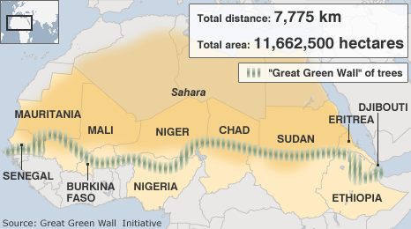
Great Green Wall
Some countries are planting trees to slow desertification.

Slide 27
Harming the Environment in Nigeria
A Major Oil Producer
Oil was discovered in Nigeria in 1956 in the Niger delta.
Nigeria is world’s 6th leading oil exporter.
There are 2 million barrels of oil extracted each day; most shipped to U.S.
Oil provides up to 90% of national income.
In 1970s, high oil prices made Nigeria one of Africa’s richest nations.
When prices fell, Nigeria owed millions to other nations, U.S.
Poor planning and corruption left Nigeria poorer than ever before.

Slide 28
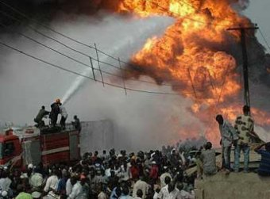
Destroying the Land and People
There have been over 4,000 oil spills in four decades with slow or no cleanup.
Acid rain and soot from oil fires lead to respiratory diseases.
Pipeline explosions kill 2,000 between 1998 and 2000
Bandits work with corrupt officials; drain pipeline fuel, and sell it.
http://www.france24.com/en/20080515-pipeline-explosion-kills-100-nigeria-nigeria
A ruptured pipeline in Nigeria
http://www.france24.com/en/20080515-pipeline-explosion-kills-100-nigeria-nigeria

Slide 29
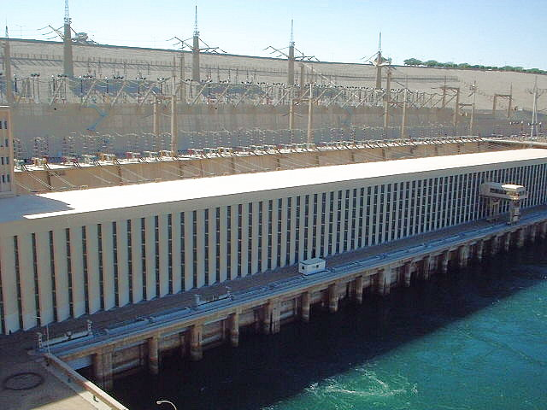
Controlling the Nile
The Aswan High Dam
Egyptians have always tried to control the Nile’s flood, and droughts.
built first Aswan Dam in 1902; quickly obsolete.
Aswan High Dam completed in 1970, creates 300-mile Lake Nasser.
Dam provides regular supply of water for farmers
holds back Nile floodwaters for irrigation
Farmers now have two, or three harvests a year
Egypt’s farmable land increased by 50%.
http://tourism-egyptnow.blogspot.com/2011/05/aswan-high-dam.html

Slide 30
Problems with the Dam
Construction meant relocating people, changing Nubian’s way of life.
Abu Simbel temples moved, but other treasures were lost at bottom of the lake.
River no longer deposits rich silt—sediment—on farmland
Irrigation raises water table.
River doesn’t flush out salts that decrease soil fertility.
Mosquitoes thrive in Lake Nasser and spread malaria, and other diseases.
Millions of gallons of fresh water lost yearly due to lake evaporation.

Slide 31
Bibliography
Mcdougal Littell, World Geography. Houghton Mifflin Company. 2012

