Slide 1
Chapter 19
Human Geography of Africa: From Human Beginnings to New Nations
Africa is the “Cradle of Humanity” and has been home to numerous empires. But today, its people’s lives are most affected by Africa’s colonial history.

Slide 2
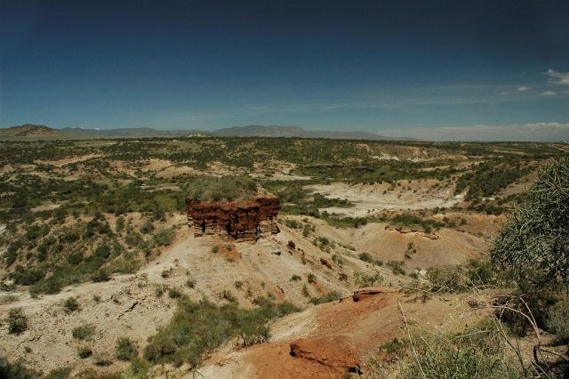
Section 1: East Africa
East Africa is known as the “cradle of humanity.”
East Africa’s location has made it a trading center.
Olduvai Gorge

Slide 3
Continental Crossroads
Cradle of Humanity
Prehistoric human remains were found in Olduvai Gorge, Tanzania.
A Trading Coast
This region includes Burundi, Djibouti, Eritrea, Ethiopia, Kenya, Rwanda, Seychelles, Somalia, Tanzania, and Uganda
In A.D. 100s, the Ethiopian civilization of Aksum traded with Egypt and Rome
In 600s, Arabs, Persians, and Indians traded in this region as well.
The important Tanzanian trading city of Kilwa flourished during this time.
This area became a cultural crossroads of goods, ideas, and people.

Slide 4
Colonization Disrupts Africa
Scramble for Africa
19th-century Europeans sought African resources to use to build up their own economies.
In 1884–85 the Berlin Conference divided Africa between European nations; African input wasn’t asked for.
Ethiopia Avoids Colonization
Emperor Menelik II protected Ethiopia from an Italian invasion in 1896.
Conflict in East Africa
Independent by 1970s, many countries suffered civil wars, and disputes.
Colonial boundaries mixed ethnic groups, and lead to internal conflicts.

Slide 5
Farming and Tourism Economies
Farming in East Africa
Countries grew cash crops for direct sale (coffee, tea, sugar).
Such crops took up farmland needed for growing food.
People left farms for cities like Addis Ababa, the capital of Ethiopia.
Rapid urban growth strained resources, and agricultural production.
Tourism Creates Wealth and Problems
Wildlife parks in Kenya, Uganda, and Tanzania attract tourists, and income.
The need for food, and farmland is threatening wildlife reserves.

Slide 6
Maintaining Traditional Cultures
Cultures of East Africa
160 different ethnic groups live in this region.
The Masai live in the rift valley grasslands of Kenya, and Tanzania.
The Masai herd livestock, farm, and make intricate beadwork and jewelry.
They wear calfskin, and buffalo-hide clothes.

Slide 7
Health Care in Modern Africa
Health Care in Africa
Africa has been devastated by the AIDS pandemic.
pandemic—disease outbreak in large population over a wide area
AIDS is caused by human immunodeficiency virus (HIV)
more people have HIV than AIDS, so AIDS numbers are misleading.
Some African governments hide the scope of the disease.
Experts fear the worst-affected countries could lose 10-20% of their populations.

Slide 8
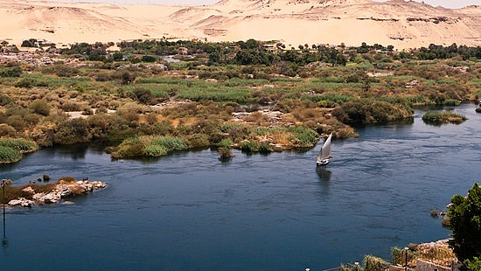
Section 2: North Africa
The Nile River valley and ancient Egypt, one of the world’s great civilizations, formed a cultural hearth.
North Africa shares the Arabic language and the Islamic religion and culture with Southwest Asia.
The Nile River Valley.

Slide 9
Roots of Civilization in North Africa
North African Countries
Morocco, Algeria, Tunisia, Libya, Egypt, Sudan
Egypt Blossoms Along the Nile
Nile’s flooding provided water and rich soil to help the civilization grow.
Nile villages united into the first Egyptian dynasty around 3100 B.C.
Egyptian geometry and medicine were spread by trade.
Carthage
Legend says the great ancient city of Carthage was founded in 814 B.C.
location on Gulf of Tunis peninsula make it a trade center

Slide 10
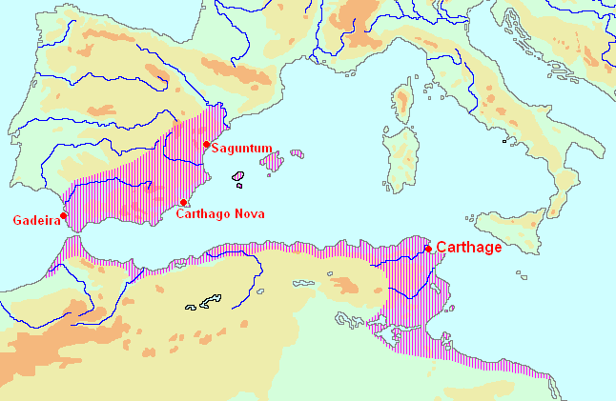
Carthage

Slide 11
Islam in North Africa
Over time this area was invaded by Greeks, Romans, Phoenicians, and Ottoman Turks.
Islam is the main cultural and religious influence.
Islam is a monotheistic religion based on Muhammad’s teachings.
Southwest Asian Muslims invaded North Africa in A.D. 632 and took Egypt in 634; they controlled the whole region by 750.
Muslims bind the territory with sea-linked trade zones

Slide 12
Economics of Oil
Black Gold
Oil has replaced cash crops, and mining as the economic base.
Oil has transformed the economies of Algeria, Libya, and Tunisia.
Oil also causes problems:
Libya’s workforce lacks training/ education to work in oil industry
High-paying oil jobs often go to foreign workers
Despite oil jobs, unemployment remains high
Libyan workers migrated to Europe for jobs

Slide 13
A Culture of Markets and Music
North African Souks
Souks (marketplaces) are located in the medina (old section of town).
The best souks are in Marrakesh, Morocco.
High-pressure sales and fierce bargaining over clothes, spices, and food occur here daily.
Protest Music
Rai is fast-paced Algerian music that was developed in the 1920s by urban youth.
Before gaining independence in 1962, rai expressed anger at French colonizers.
Today, rai is criticized by Islamic fundamentalists for its Western style.
Rai is now a form of rebellion against Islamic fundamentalists

Slide 14
Changing Roles of Women
Women and the Family
Homes are centered around males, few women work after marriage.
Women’s roles are changing, especially in Tunisia.
Multiple wives are prohibited; both spouses can seek divorces.
High spouse-abuse penalties; no more arranged marriages for young girls.
More women have professional jobs, with equal pay for equal jobs.
Women hold 7% of Tunisian parliamentary seats and manage 9% of businesses in Tunis, Tunisia’s capital.

Slide 15
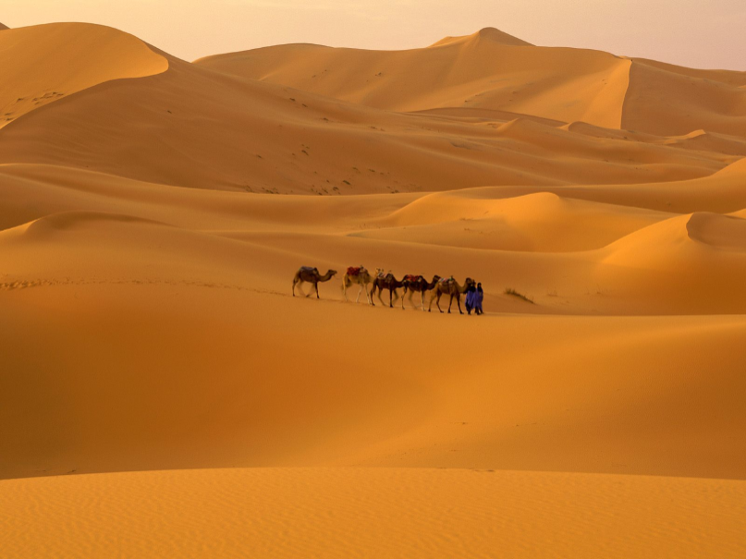
Section 3: West Africa
The Nile River valley and ancient Egypt, one of the world’s great civilizations, formed a cultural hearth.
North Africa shares the Arabic language and the Islamic religion and culture with Southwest Asia.

Slide 16
A History of Rich Trading Empires
The Slave Trade
Gorée Island off coast of Senegal was a departure point for slaves during the slave trade, mid-1500s to mid-1800s.
Europeans moved 20 million Africans through the island.
20% of Africans died in transit to the Americas.
West African Countries
West Africa includes Benin, Burkina Faso, Cape Verde, Chad, Cote d’Ivoire, Gambia, Ghana, Guinea, Guinea-Bissau, Liberia, Mali, Mauritania, Niger, Nigeria, Senegal, Sierra Leon, Togo

Slide 17
Stateless Societies
Stateless society—people rely on family lineages to govern themselves
no elected government or monarch; members cooperate, share power
lineage—family or group descended from common ancestor
for example, the Igbo of southeast Nigeria
1700–1800s, African stateless societies are challenged by colonizers
Europeans expect societies to be governed by single ruler

Slide 18
West Africa Struggles Economically
Ghana’s Stability
Post-colonial switch to democracy brought military rule, civil war
past decade’s free elections and political stability grow the economy
Problems in Sierra Leone
Once produced high-quality diamonds, but civil wars destroyed economy
Low 31% literacy rate means few skilled workers
Poor transportation system, few highways and roads

Slide 19
Music in Daily Life
West African Music
Popular music blends traditional with jazz, blues, reggae
often use French, English lyrics to attract international audience
Played on drums and instruments like the kora
kora, from Guinea-Bissau, a cross between harp, lute
Nigeria’s “minister of enjoyment,” King Sunny Adé, is very popular

Slide 20
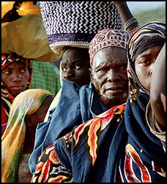
Section 4: Central Africa
The Bantu migrations helped to populate the African continent.
European nations divided Africa without regard to ethnic groups or language.
Bantu People

Slide 21
Bantu Migrations and Colonial Expansion
Central African Countries
Cameroon, Central African Republic, Democratic Republic of the Congo, Republic of Congo, Equatorial Guinea, Gabon, São Tomé and Princípe
Bantu Migrations
Bantu migrations—2000 B.C., Bantu of southeastern Nigeria moved southward across Africa.
land shortage may have sent them south spreading language, culture
Migrations created cultural diversity, but languages link continent
forms of Bantu spoken by 120 million Africans today

Slide 22
The Slave Trade
Europeans wanted slaves for plantations in Americas
In 1400s, Portugal established base on island of São Tomé off Gabon
slave traders exchange guns, goods for captive Africans
Many African rulers sold slaves to other Africans, Arabs, Europeans
By end of trade in 1870, millions had been taken to Americas, Europe

Slide 23
Start of Colonialism
Until mid-1800s, Europeans don’t move far inland
Belgium’s King Leopold II opens Congo trade, controls interior by 1884
holds Berlin Conference, forms Congo Free State
uses forced labor to get rubber, palm oil, ivory
Effects of Colonialism
Belgium, France colonize region; most countries independent by 1960s
European borders disrupt traditional governments and ethnic regions
new governments face diverse populations, corrupt leaders

Slide 24
The Economic Legacy of Colonialism
Economic Effects
Lost resources; cultural, ethnic oppression of people
Little infrastructure or money for transportation or education systems

Slide 25
Improving Education
Education Faces Barriers
In 2001, less than half the sub-Saharan young adults attend school
shortage of teachers and secondary schools, high dropout rate
Language problems: different languages spoken in homes, schools
Learning in Central Africa
In Cameroon, most children leave school at age 12
In Central African Republic, kids 6 to 14 are required to attend school
Cameroon, Gabon, Republic of the Congo are adding higher education

Slide 26
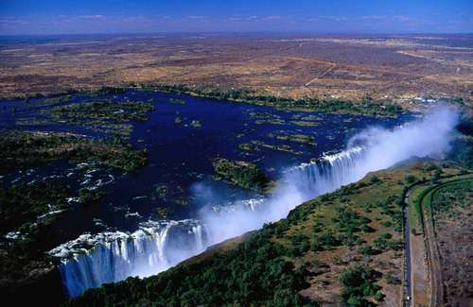
Section 5: Southern Africa
Great Zimbabwe and the Mutapa Empire thrived on the gold trade.
The wealth of Southern Africa is tied to the land, and conflicts over land and resources often result.
Victoria Falls, Zimbabwe

Slide 27
Gold Trade Builds Empires
Southern African Countries
Angola, Botswana, Comoros, Lesotho, Madagascar, Malawi, Mauritius, Mozambique, Nambia, South Africa, Swaziland, Zambia, Zimbabwe
Gold Trade Spawns Great Zimbabwe
Great Zimbabwe — Shona people form a major gold-trading city around 1000
abandoned around 1450
Mutapa Empire
Legend says Mutota founded new state in 1440
Mutapa Empire soon covered almost all of Zimbabwe
Thriving gold empire declines in 1500s amid Portuguese interference

Slide 28
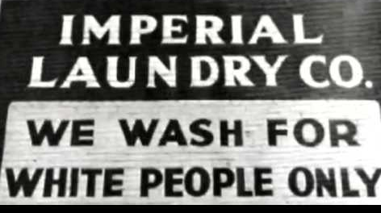
The Institution of Apartheid
The Policy of Apartheid in South Africa
Racial tensions had existed in South Africa since the arrival of the Boers in the 1600s.
In 1948, an all white South African government instituted the policy of apartheid.
The word Apartheid means “apartness”
Apartheid was a policy of complete separation of different races in schools, hospitals, neighborhoods.
During this time, Blacks made up 75% of population, but owned less than 15% of the land.

Slide 29
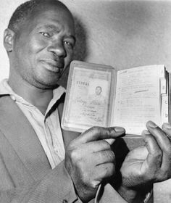
The Institution of Apartheid
In 1949, the South African government banned all inter-racial marriages.
In 1950 the Group Areas Act was passed to specify separate areas for separate races.
White and black people would live and work in different neighborhoods.
All public facilities were segregated. (Schools, courts, hospitals.)
All blacks were required to carry ``pass books'' containing fingerprints, photos, and information.

Slide 30
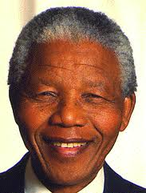
The Institution of Apartheid
Blacks had formed the African National Congress (ANC) in 1912 to seek rights, but had not been successful.
Nelson Mandela was a leader of the African National Congress. He was imprisoned in 1962 and accused of being a traitor.
Nelson Mandela

Slide 31
The Institution of Apartheid
Apartheid hurt the South African economy.
Other nations imposed economic sanctions on South Africa.
South Africa was forced out of the British Commonwealth in 1961.
Violent protests destroyed businesses/ communities.
A majority of young blacks were uneducated.
Two economies developed in South Africa:
An upper-middle income class in industrial cities like Johannesburg and Cape Town.
And a poverty-stricken class in poor rural areas, black townships, and shantytowns.

Slide 32
The Institution of Apartheid
In late 1980s, under pressure from the rest of the world, South Africa began reforming the Apartheid system.
F.W. de Klerk, a leader of the National Party, became president in 1989.
President de Klerk worked to end Apartheid and restore balance to the government of South Africa.
Nelson Mandela was freed from prison in 1990 and elected president in 1994.
A new, democratic constitution passed in 1996 officially putting an end to the institution of Apartheid.
F.W. de Klerk

Slide 33
Success at a Cost
Botswana became independent from European powers in 1966, and had long-term economic growth.
world’s third-largest diamond producer
diamonds account for 63% of government revenue
Diamonds make 20% of the population rich, but 80% are farmers who don’t benefit.
Rich buy land for cattle, force off farmers, increase meat production
but overall food production is only 50% of what’s needed

Slide 34
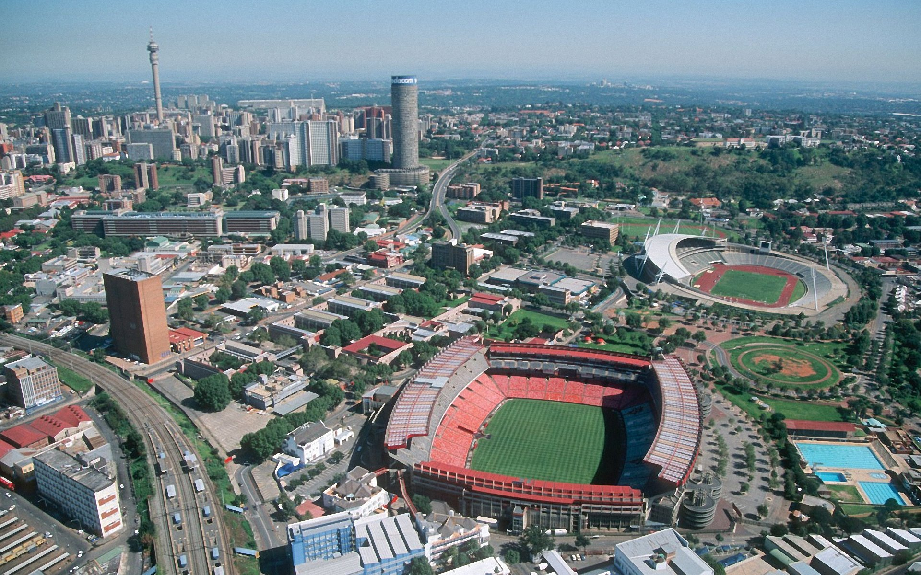
Living in Southern Africa
Johannesburg
Grew from small gold mining town 100 years ago to 6 million people
Because of apartheid, Johannesburg grew into two cities
all-white suburbs in north, poor black townships in south
Modern and Traditional Lifestyles
Some live modern lives as doctors, lawyers, professionals in suburbs
Many blacks work menial jobs and live in homelands, and shantytowns
Some ethnic groups keep traditional lifestyles
work as farmers, traders, herders, metalworkers (like Zulu)

Slide 35
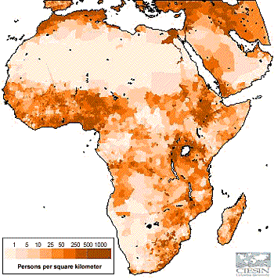
Population Distribution
(Earthobservatory.nasa.gov)

