Slide 1
Essential Question:
What were the important characteristics of the civilizations in Mesopotamia?
Warm-Up Question:
Why was the Neolithic Revolution such a big deal?
Which of the 5 characteristics of civilizations do you think is most important?

Slide 2
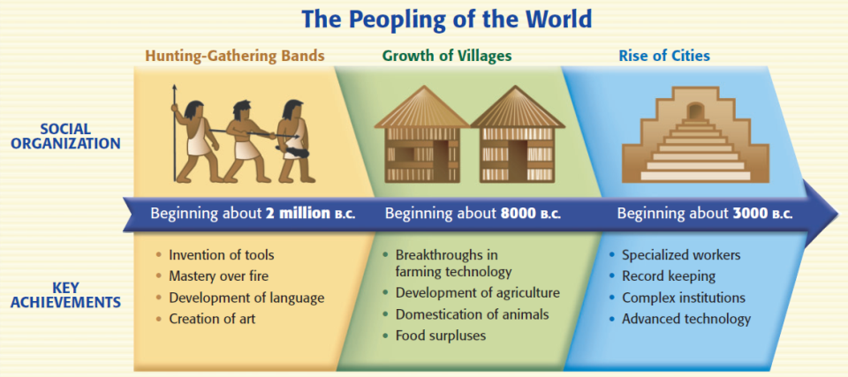
River Valley Civilizations
The discovery of farming during the Neolithic Revolution allowed nomadic people to settle into civilizations

Slide 3
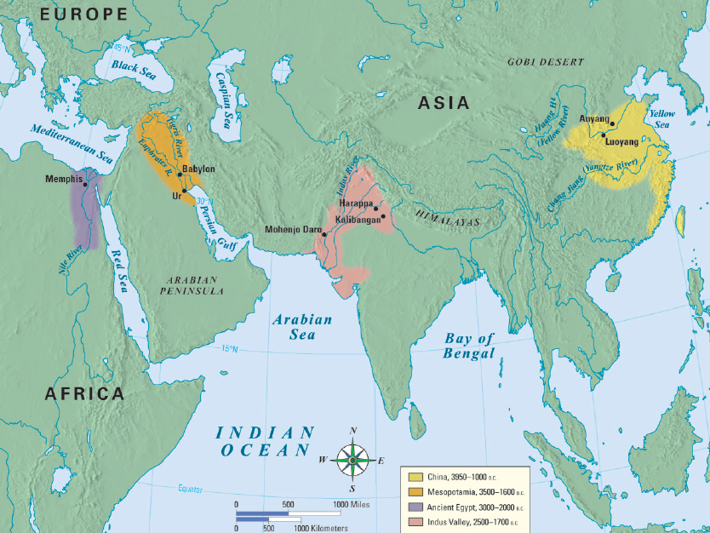
The world’s first civilizations all began in river valleys
The first civilization began in an area known as Mesopotamia

Slide 4
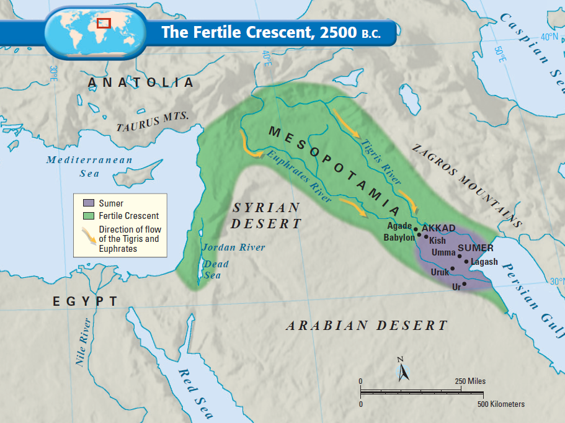
Mesopotamia means “land between the rivers” & is often called the “Fertile Crescent” or as the “Cradle of Civilization”
The Tigris and Euphrates Rivers flooded once per year, leaving behind fertile soil ideal for farming
Notes:
River flooded unpredictably

Slide 5
The first civilization developed in the Fertile Crescent: Sumer
But, surrounding deserts & the lack of natural barriers attracted outsiders to Mesopotamia made the Sumerians vulnerable to attack

Slide 6
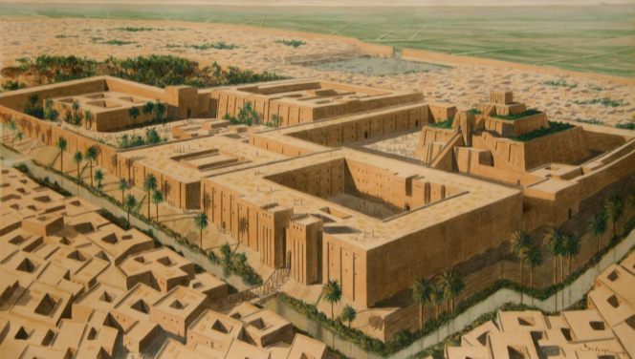
Lasting Contributions
Advanced cities:
Sumerian city-states were protected by high walls
At the city center was a temple called a ziggurat

Slide 7
Lasting Contributions
Specialized Workers:
At the top of society were priests, and then kings
In the middle were skilled workers, like merchants
At the bottom, were common farmers & slaves

Slide 8
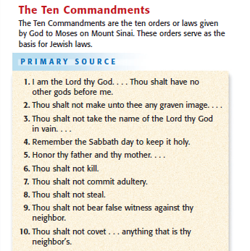
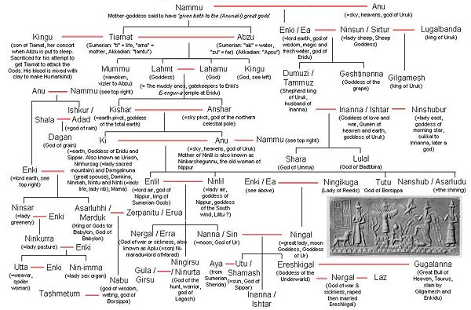
Lasting Contributions
Religion:
Sumerians & Babylonians were polytheistic
The Hebrews in Palestine were the 1st monotheistic faith in history (Judaism)
The holy book of Judaism is the Torah; God gave Moses the Ten Commandments which serve as moral laws

Slide 9
Lasting Contributions
Government:
Babylonian King Hammurabi created the first legal code
Hammurabi’s Code had 282 laws based on justice & retaliation (an eye for an eye)
The code had different punishments for the various levels of society

Slide 10
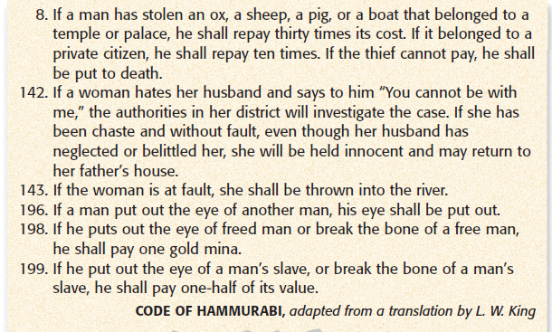
Lasting Contributions

Slide 11
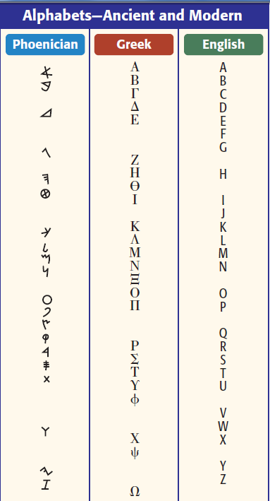
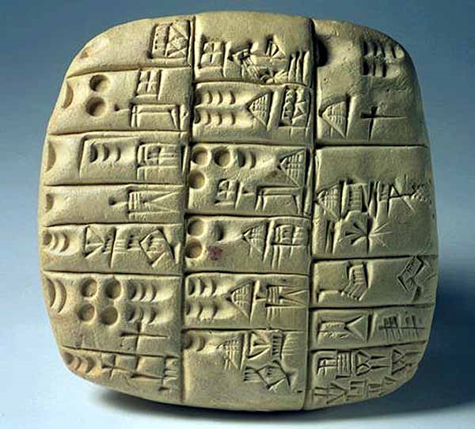
Lasting Contributions
Writing:
Sumerians made the world’s 1st writing called cuneiform
Phoenicians simplified cuneiform to a 22 letter alphabet
Phoenician merchants spread the alphabet throughout the Mediterranean world
The alphabet influenced Greek, Latin, & English

Slide 12
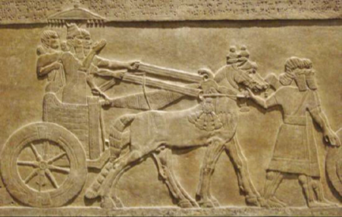
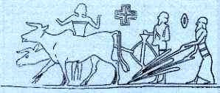
Lasting Contributions
Technology:
Sumerians inventions include the wheel, sail, plow, & bronze metalwork

Slide 13
Closure Activity
Examine the following primary source documents and answer the questions. Write a paragraph answering the following question (give evidence from the documents): Was Hammurabi’s Code just?

